Slide 1
AMAZING MAZES
Some of the ‘AMAZING’ mazes from our students

Slide 2
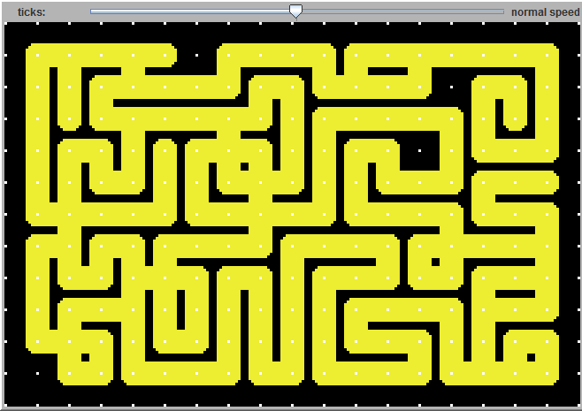
CREATORS: BRIANNA and DEANA

Slide 3
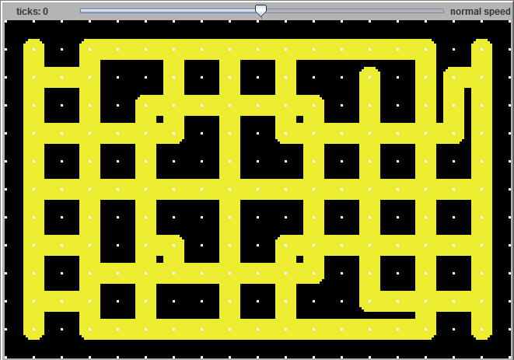
CREATOR: Malia

Slide 4
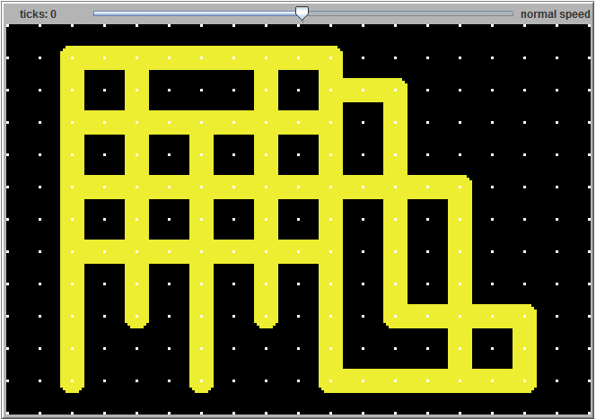
CREATOR: JUSTIN

Slide 5
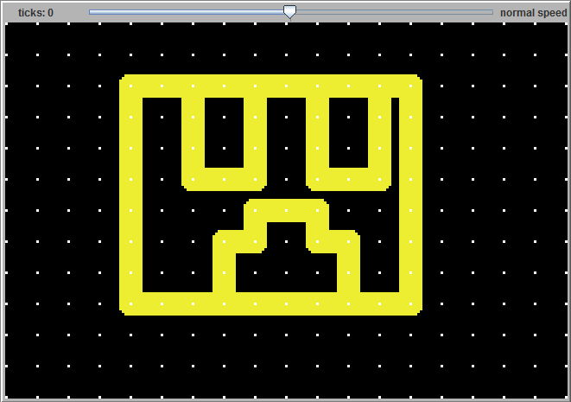
CREATORS: Yazmine and monica

Slide 6
Isn’t it AMAZING ? … want to see it again?

